Slide 1
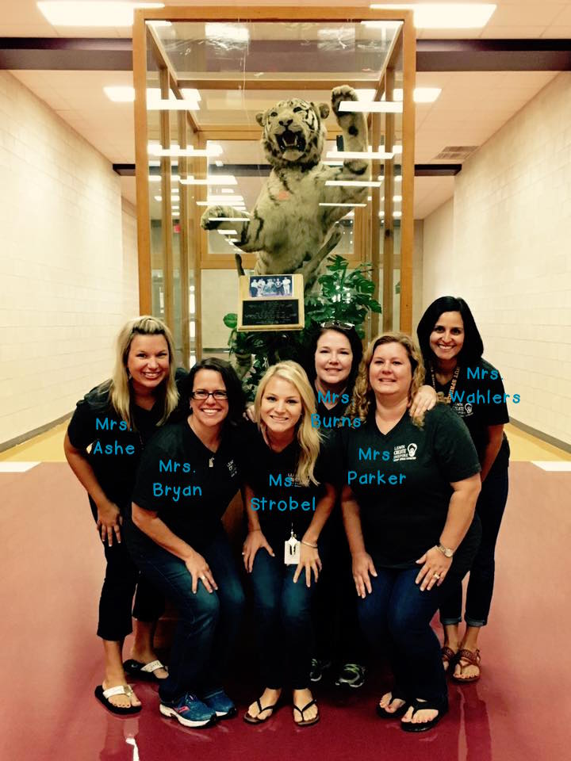
Kindergarten Parent Orientation

Slide 2
Arrival and Dismissal
Students may arrive as early as 7:00 and will be supervised in the cafeteria.
At 7:35, students will be escorted to class by grade level.
Breakfast is served until 7:40.
Students that arrive late or that enter the line at 7:40 will take their tray “to-go”
The TARDY bell rings at 7:45am.
Please make sure your child is here on time – class begins at 7:45!
Students not in the building at 7:45 will receive a Tardy Slip
Kindergarten is dismissed at 2:55
If you are picking up a PK/Kindergartner ONLY, you may bypass the line and pull forward at 2:50
If you are also picking up children in grades 1-5, you will need to wait until 3:00
Busses depart Walnut Springs at 3:12
If you need to pick your child up prior to the scheduled dismissal time, you MUST check them out through the office.

Slide 3
Arrival and Dismissal, cont.
Making Dismissal/Transportation changes
send a note in your child’s TIGER Binder-OR-
call the office BEFORE 1:00pm and they will send down a Change in Transportation Form
NOTE: We are not able to change your child’s mode of transportation based on what your child says. We MUST have a note or call from you.
Students will not be released for early pickup after 2:44.
If you need to pick up your child early, please do so BEFORE 2:45. At that time, all students will be dismissed according to their regular plan
Please send a written note, email or Doctor’s excuse when your child is absent
Diana Perry, Registrar
Email: Diana.perry@dsisdtx.us Website:
Absence notes/excuses can also be submitted through Skyward
AWARDS are given for PERFECT Attendance and EXCEPTIONAL Attendance.
Perfect Attendance: only 3 tardies or early dismissals allowed
Exceptional Attendance: ZERO tardies; ZERO early dismissal; ZERO absences

Slide 4
Be sure to send...
TOWEL (for daily Read to Self)
No blankets or towels larger than a standard beach towel, please
No pillows or “nap mats”
Label the towel with your child’s name
Practice rolling or folding the towel to fit in a cubby
Towels will go home each Friday to be washed
Change of Clothes
Put the following in a GALLON ZIP BAG labeled with your child’s name:
Shirt, shorts, socks and underwear (label items with name)
Empty gallon bag (for taking home “dirties” when necessary)
Not all accidents are potty related, so please save yourself a trip by keeping a change of clothes handy all year!

Slide 5
Snacks & Water
We have snack time every afternoon. Please send a small, HEALTHY SNACK
Healthy Snack ideas: crackers, dry cereal, fruit, vegetables, raisins, beef jerky, cheese
Please DO NOT send juice, fruit cups (they spill - sticky!) or anything requiring a fork/spoon or refrigeration.
Please send a NON-LEAKING WATER BOTTLE EVERY DAY for recess as we do not have access to a drinking fountain while outside.
Please avoid open-mouth water bottles. Those with no-spill sipping tops are best.
Please LABEL your child’s water bottle!
Due to a staff member’s SEVERE MANGO ALLERGY, do not send snacks or juices with mango (also, please check lotions, lip balm, hand sanitizer, etc for mango before sending to school)

Slide 6
T.I.G.E.R. Binder Today I’ve Got Everything Ready
For the 1st week, we will use YELLOW FOLDERS
Please be sure to look in your child’s folder for important papers every day and return the folder to school
We will begin sending home TIGER Binders the 2nd week of school
(More information will come regarding how we will use the TIGER Binder)
Let your teacher know if you are able to assist in assembling the TIGER Binders

Slide 7
Homework
Homework will be sent home beginning in October
Kindergarten homework will consist of a monthly Choice Board
Completing the Choice Board is optional, but students that do so will earn a prize!
In the meantime (and throughout the school year), we can not over emphasize the importance of READING NIGHTLY with your child. Another helpful activity is to practice letter names/sounds and Sight Words
NOTE: Homework and Kinder Charts will be located in your child’s TIGER Binder

Slide 8
Leader In Me
District-wide Initiative
Based on Steven Covey’s The Seven Habits of Highly Effective People
Be Proactive
Begin with the End in Mind
Put First Things First
Think Win-Win
Seek First to Understand, Then to be Understood
Synergize
Sharpen the Saw
Find Your Voice

Slide 9
Classroom Management
Each teacher has a different system for classroom management
A Behavior/Leadership Report will be sent home daily (TIGER Binder)
More information will follow from your child’s teacher during the 1st week of school

Slide 10
What can we do at home?
iStation
RAZ-Kids
Dreambox
READ! READ! READ!
Login info
will come home soon!

Slide 11
Curriculum
Language Arts
Balanced Literacy/Daily 5:
whole group lessons, small groups focused on instruction in phonemic awareness, reading and writing, independent & partner work in centers
Lucy Calkins Writer’s Workshop
Handwriting Without Tears
Math
Pearson Envision
whole group lessons, small groups and math stations
Numerical Fluency
Number Lab
Science
Stemscopes
uses the 5 E’s: Engage, Explore, Explain, Elaborate, Evaluate
Science Lab

Slide 12
Assessments
DRA 2 (Developmental Reading Assessment)
January and May (and as needed)
iStation (Reading progress)
Scores will be reported to the state 3 times during the year.
Numerical Fluency
Throughout the year
Report Cards
Interim Grades (i.e. Progress Reports) will NOT be given in Kindergarten
Report Cards are viewable online via Skwyard (Family Access) 4 times during the year

Slide 13
“The Center” for Learning and Innovation
We go to the Library every week (beginning the 3rd week of school)
Students will check out a book each
Each child must return his/her book before checking out another book.
MYSTERY READERS!!
I will be sending a Sign-up Genius – be sure to sign up for a day to surprise our class as the Mystery Reader
Read Aloud (~10-15m) Help Choose Books (~15-20m)
You may bring/choose your own book, but I will have one, too, just in case ☺

Slide 14
Dining Hall
Kindergarten Lunch is 11:00 – 11:30
You are welcome to eat lunch with your child any time
Please arrive before 11:00 in order to sign in at the office & wait for our arrival
Lunch Money
Student Lunches: $2.75 Adults: $3.50
Paying online via PayPams is preferred
Access PayPams via the “Meal Payments” button on the DSISD homepage
-or- Send money in an envelope marked with your child’s FULL name & amount
Dining Hall Snacks
Snacks are available for purchase in the Dining Hall during lunch
Parents wishing to allow snack purchases must submit the form from Child Nutrition (by default, PK & K students are NOT able to purchase snacks without this form)
Snacks range from $0.50 to $1.00

Slide 15
Birthdays
We celebrate every child’s birthday in the classroom, including summer birthdays (more info to come).
If you would like to provide a birthday treat for the class, please send enough for 22 students.
You can send them with your child in the morning or bring them to the office.
Treats should be sent in individual portions (ie cupcakes, cookies, donuts)
Please do not send anything that needs to be refrigerated
Please do not send toys or cupcakes with rings, etc on the top
Birthday invitations passed out in class must include every student. Otherwise, please mail the invitations.
New ideas coming soon for honoring birthdays!

Slide 16
Field Trips & Parties
Field Trips
Students should wear their Field Trip t-shirts!
Fire Station (walking)
Sweet Berry Farms (bus)
Zach Scott Theater (bus)
NOTE: The Field Trip fee ($20/year) should be paid online ASAP
Skyward/Family Access → Fee Management
Parties
Winter (Friday, December 16)
Valentine’s Day (Tuesday, February 14)
End of the Year: Water Blast Day (Wednesday, May 31)

Slide 17
Background Checks
All parent volunteers and chaperones MUST have background checks completed PRIOR to working with or managing students
If you think you might fall into one of those categories, please pick up the background check application (2 pages)
Must be submitted YEARLY

Slide 18
P.T.A.
http://www.wsepta.com
Dues
$10 per adult(not family)
Join ASAP and help our class win a prize!
Field Trip t-shirts ($10)
Order via order form
-OR- order them online
Box Tops & Labels for Education

Slide 19
Student Led Conferences
Fall: Tuesday, November 15 @ 8:00am
Spring: Tuesday, April 4@ 8:00am
If at anytime you would like to meet with your child’s teacher, just send a note in your child’s TIGER Binder, call or send me an email.

Slide 20
It’s Time to
Meet Your Teacher!
TEACHER ROOM #
Ashe 311
Wahlers 309
Burns 308
Parker 306
Strobel 305
Bryan 303

